Slide 1
Tips for Writing a Research Abstract and Creating a Research Poster LAsBEST@USC Summer Seminar July 1, 2022
Cecilia M. Patino-Sutton MD PhD MeD

Slide 2
Goals for today
Tell you about my background and why I am interested in you!
Introduce you to some useful resources for:
Writing a successful scientific abstract
Developing a successful scientific poster
Go over some practical recommendations
Discuss roadblocks to creating research abstracts and posters

Slide 3
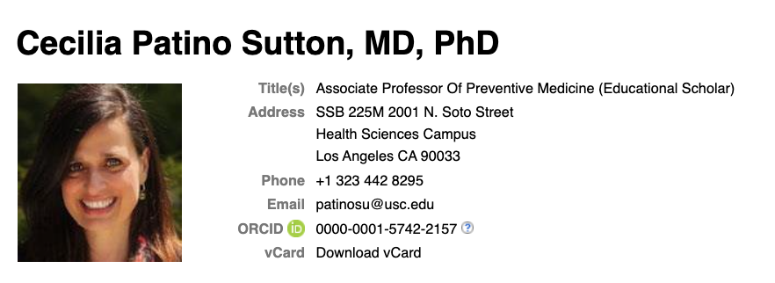
https://profiles.sc-ctsi.org/cecilia.patinosutton
patinosu@med.usc.edu
Lead Master
Clinical Translational Research
PI NIH Training Grant in Clinical Translational Research
Research Interest
Asthma
Educational Interventions

Slide 4
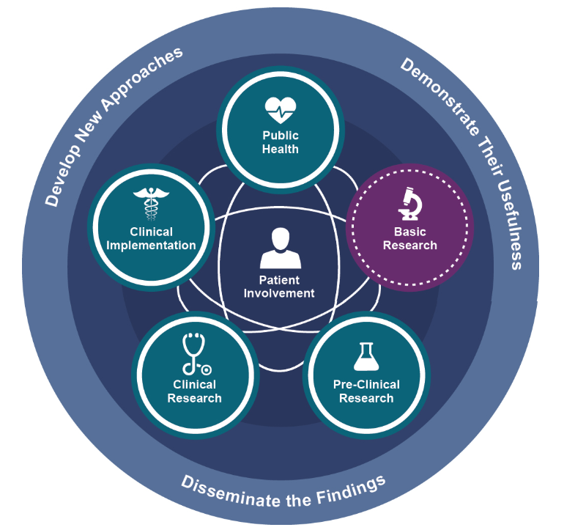
Clinical and Translational Research Paradigm
Impacto
▾Severidad
▾Internaciones
▾Costo
▾Mortalidad
▵Calidad de vida
https://ncats.nih.gov/translation/spectrum
Notes:
Explain the translational paradigm and our obligation to propogate translation.

Slide 5
Why I am Interested in You.....
I am interested in improving the health of humans by training researchers to conduct high quality, rigorous and reproducible research studies
High quality research has a better chance of improving the health of individuals
High quality reporting of research has a better chance of getting buy-in from the health community and thus getting translated to health care decision making.
As a researcher you will need to write research abstracts and present posters:
As part of a research training program
When presenting your research at a conference
When Applying for a grant
When Publishing
Thus, high quality reporting of research within the context of a research abstract and a poster are of key importance
The abstract and poster may be the only product that is read by the research community!

Slide 6
Research Abstract: Definition
It is an abbreviated and structured description of a research study
Short summary of the completed research

Slide 7
Have you ever written a Research Abstract?
What strategy did you use?

Slide 8
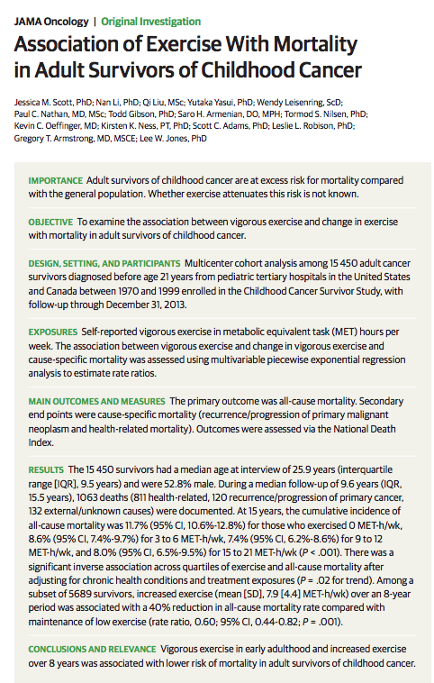
This is a study about the association between an exposure and an outcome.
What other types of studies are there?
The sections of the abstract can vary based on the study type.

Slide 9
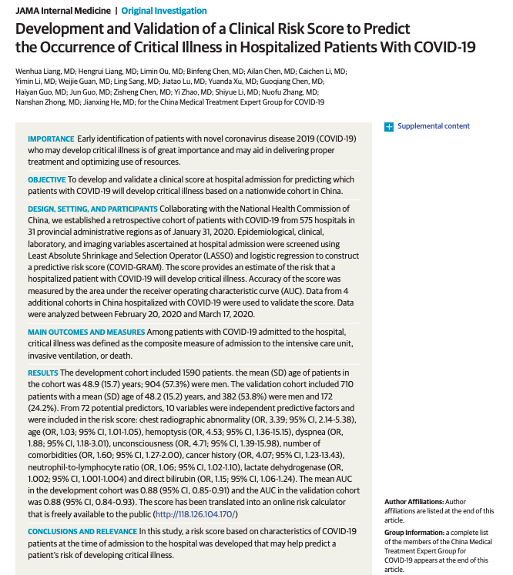

Slide 10
What other types of study designs are there?
Association
Association (causal)
Prediction
The structure and information of an abstract will depend on the study design of the research.

Slide 11

A tool to help you write a rigorous abstract for your study.
https://www.equator-network.org/reporting-guidelines/

Slide 12

https://www.equator-network.org/reporting-guidelines/

Slide 13
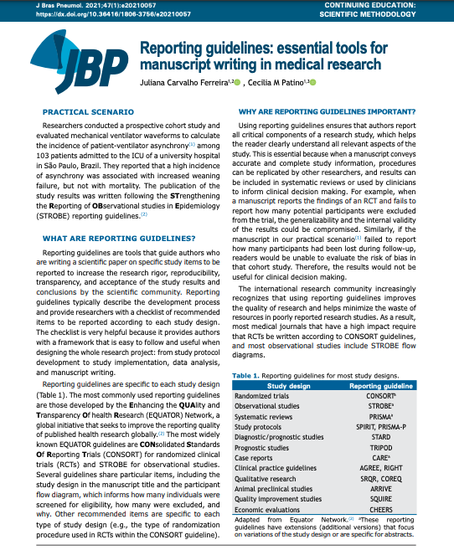
What is a reporting guideline?
It is a tool that guides a researcher when writing scientific papers on the items that should be included in each section of the paper, including the ABSTRACT!!!
The items of a reporting guideline will depend on the study design of the study.

Slide 14
https://www.equator-network.org/reporting-guidelines/

Slide 15
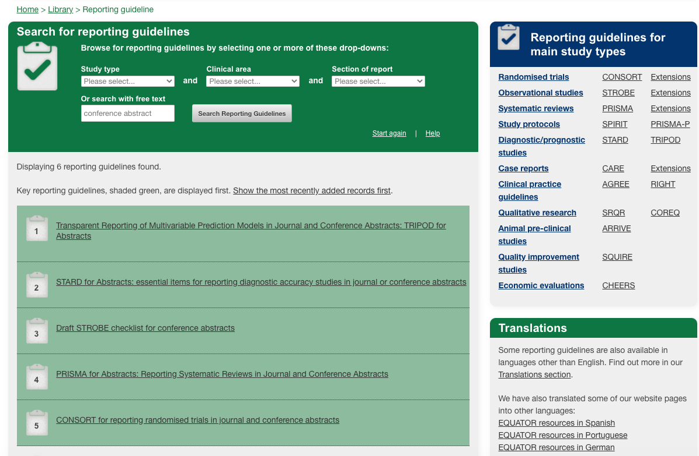

Slide 16
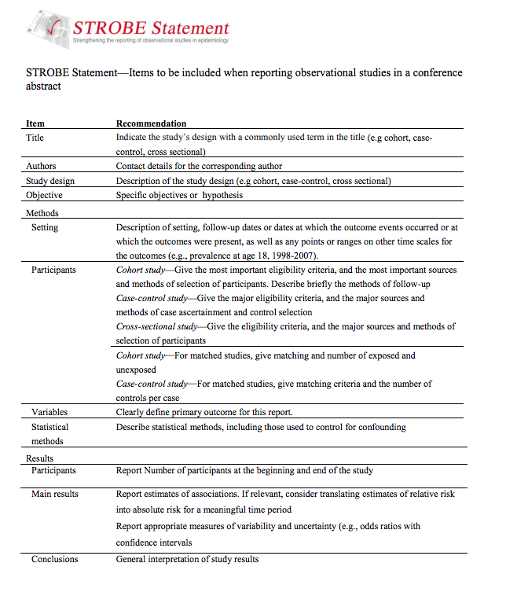
Link to reporting guideline

Slide 17
Abstract: Summary and Lessons Learned
Specific section that you need to write, and format according to the study design
There are very useful online resources that can guide you (EQUATOR network)
Title should ALWAYS! include the study design
Abstracts should catch your audience’s attention!
Using reporting guidelines makes the process of writing more efficient

Slide 18
Have you ever created and presented a Research Poster?
What strategy did you use?

Slide 19
Poster Presentation
These are the Goals of your program
Develop skills
Data management and exploration
Develop and implement a data analysis plan
Summarize the research results
Interpret the research results
Teamwork
Poster development and presentation
Summarize the setup of the study from which the dataset came from
Describe the methods used in analyzing the data
Describe the main findings from the analysis
Describe the conclusions drawn from the main findings

Slide 20
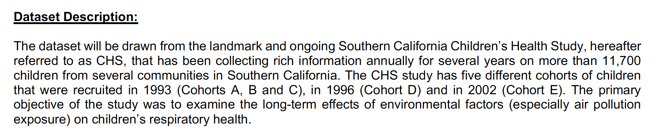
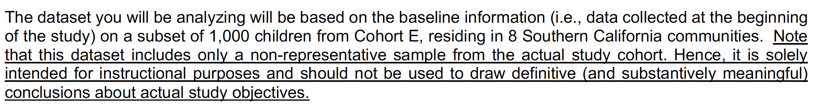
LA BEST Dataset Description

Slide 21
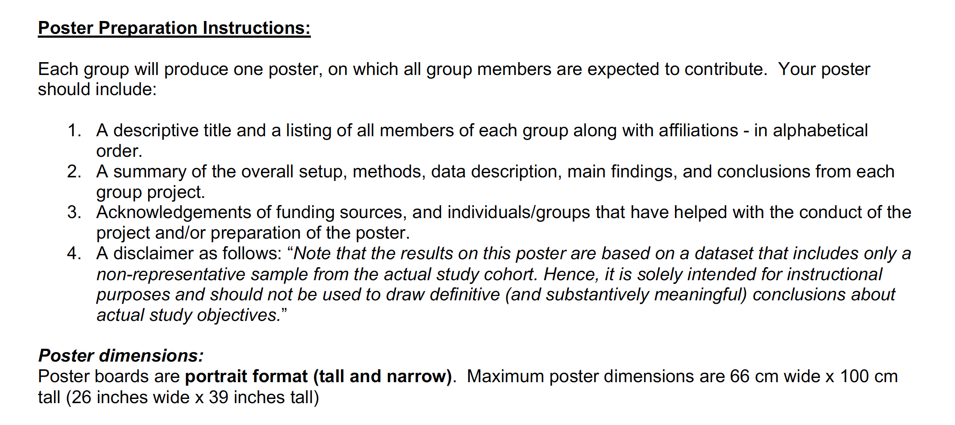
LA Best Poster Presentation Guidelines

Slide 22
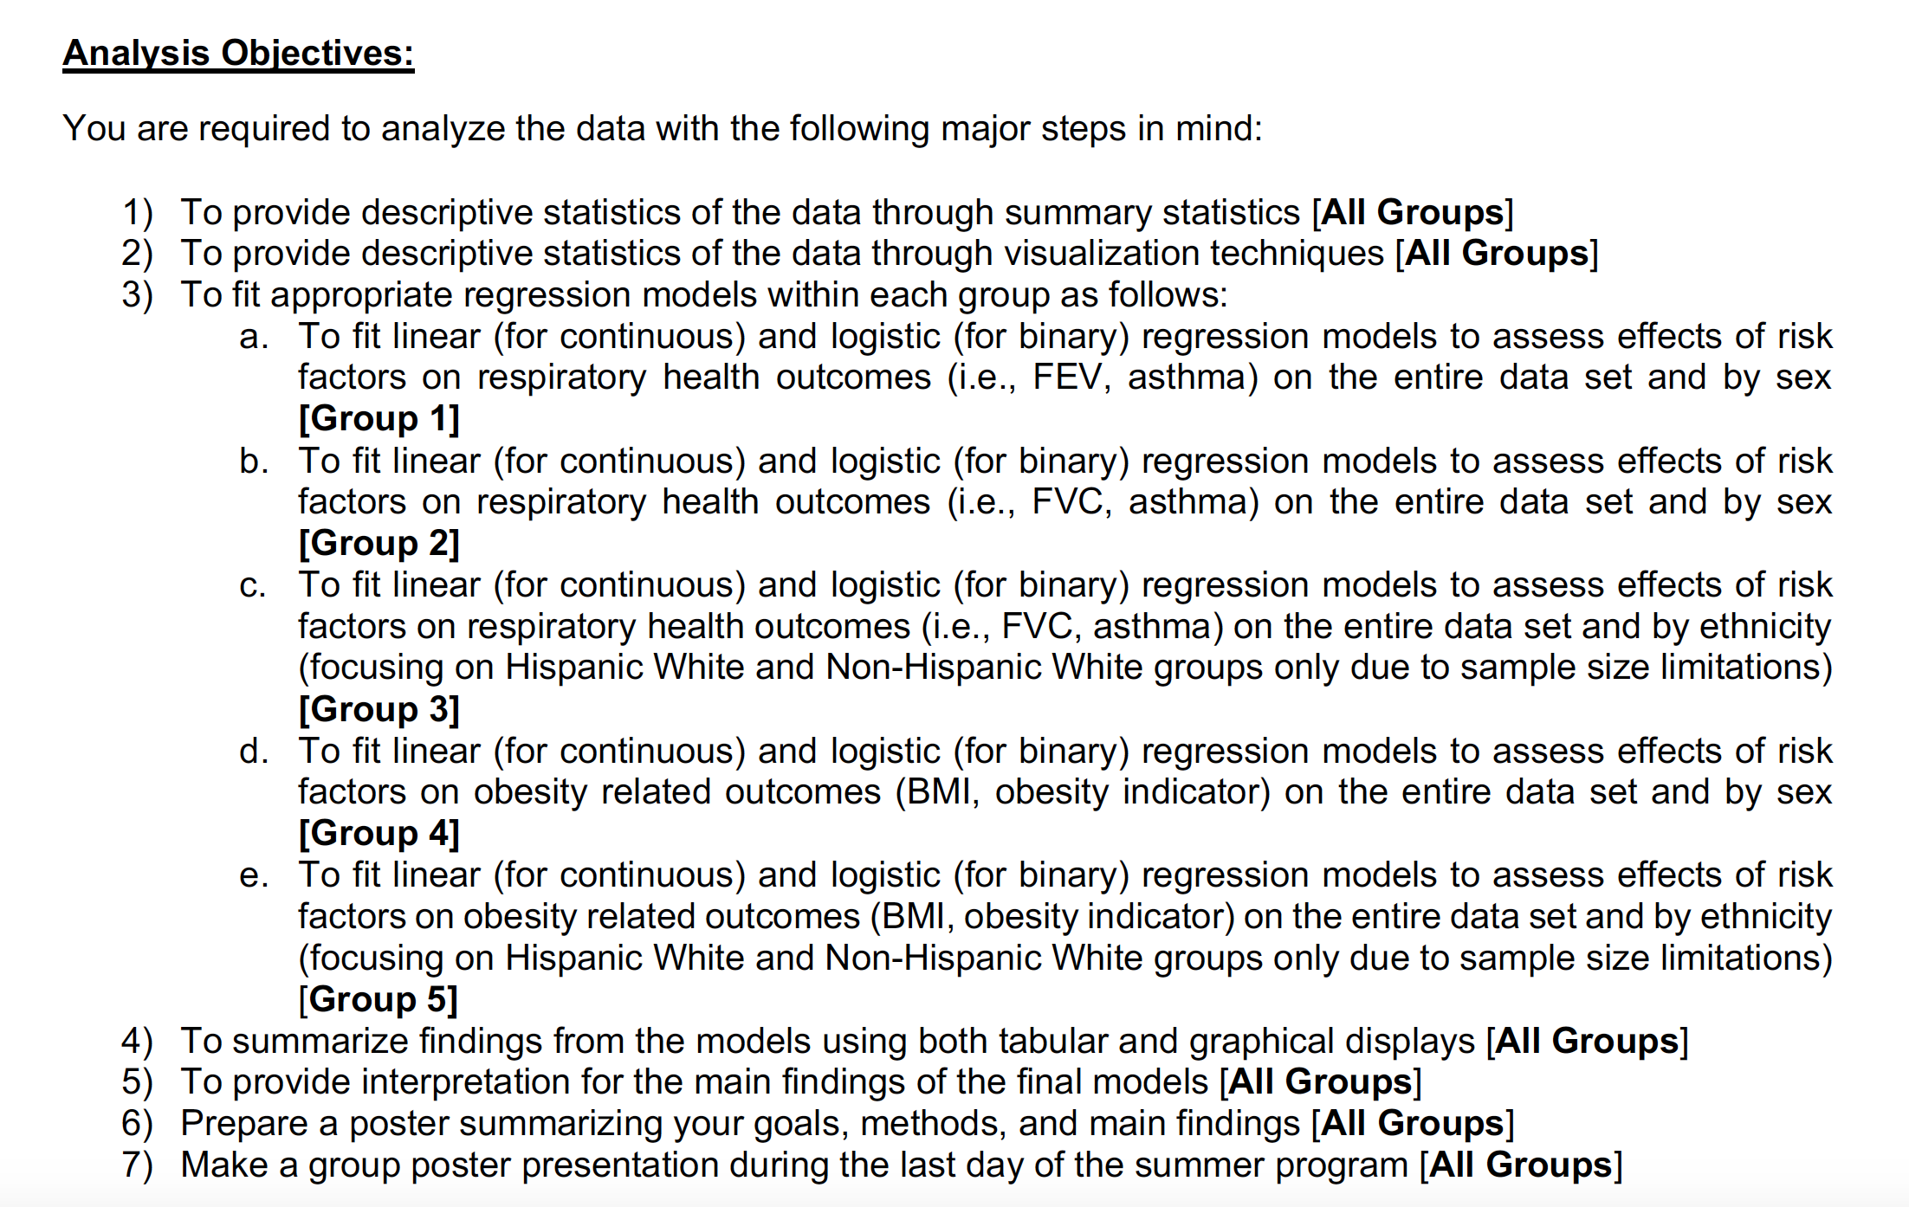
Analysis Objectives

Slide 23
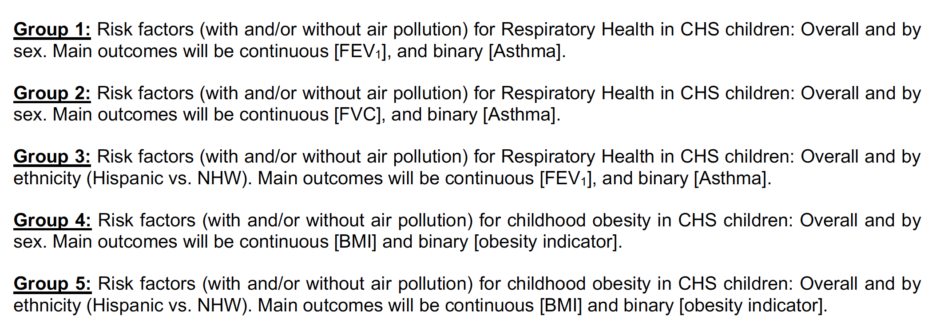
Group Projects

Slide 24
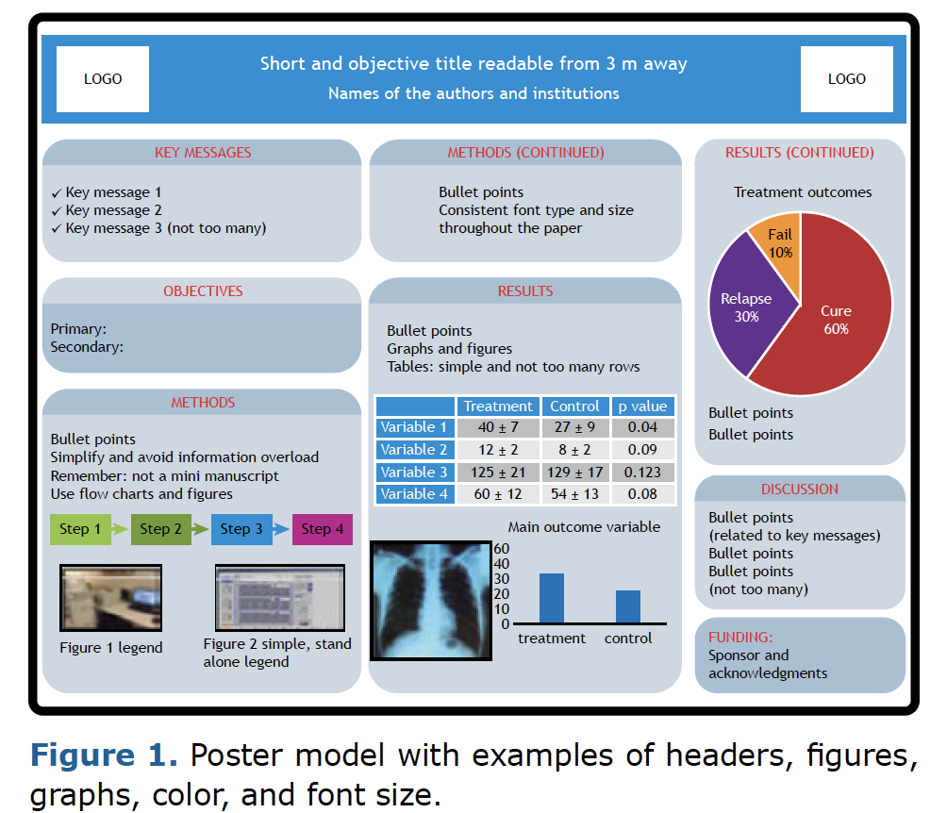

Example of a Poster Layout

Slide 25
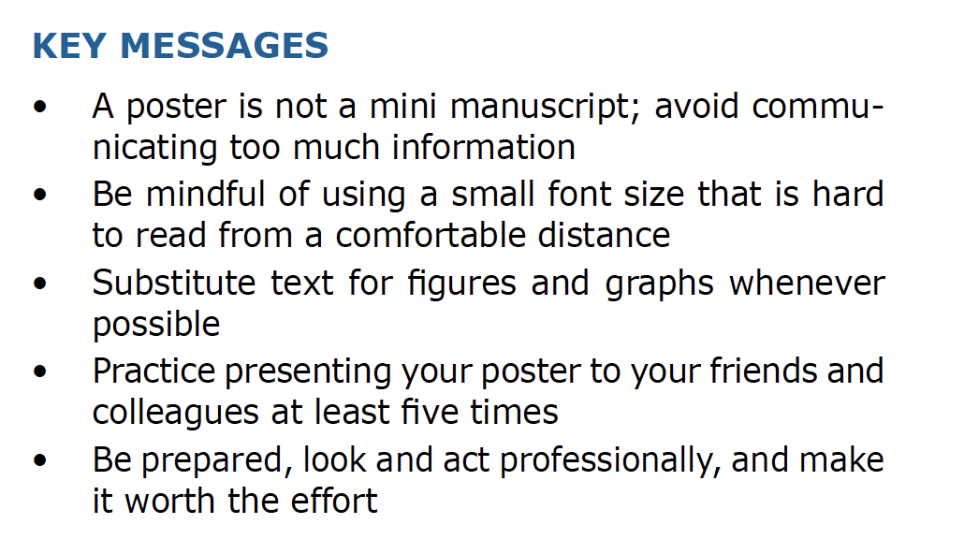

Slide 26
LAsBEST@USC Instructions
Provide Descriptive Statistics
summary statistics
visualization techniques
Fit regression models
Summarize findings using tabular and graphical displays
Provide interpretation of main findings and final models
Prepare poster summarizing
Goals
Methods
Main findings

Slide 27
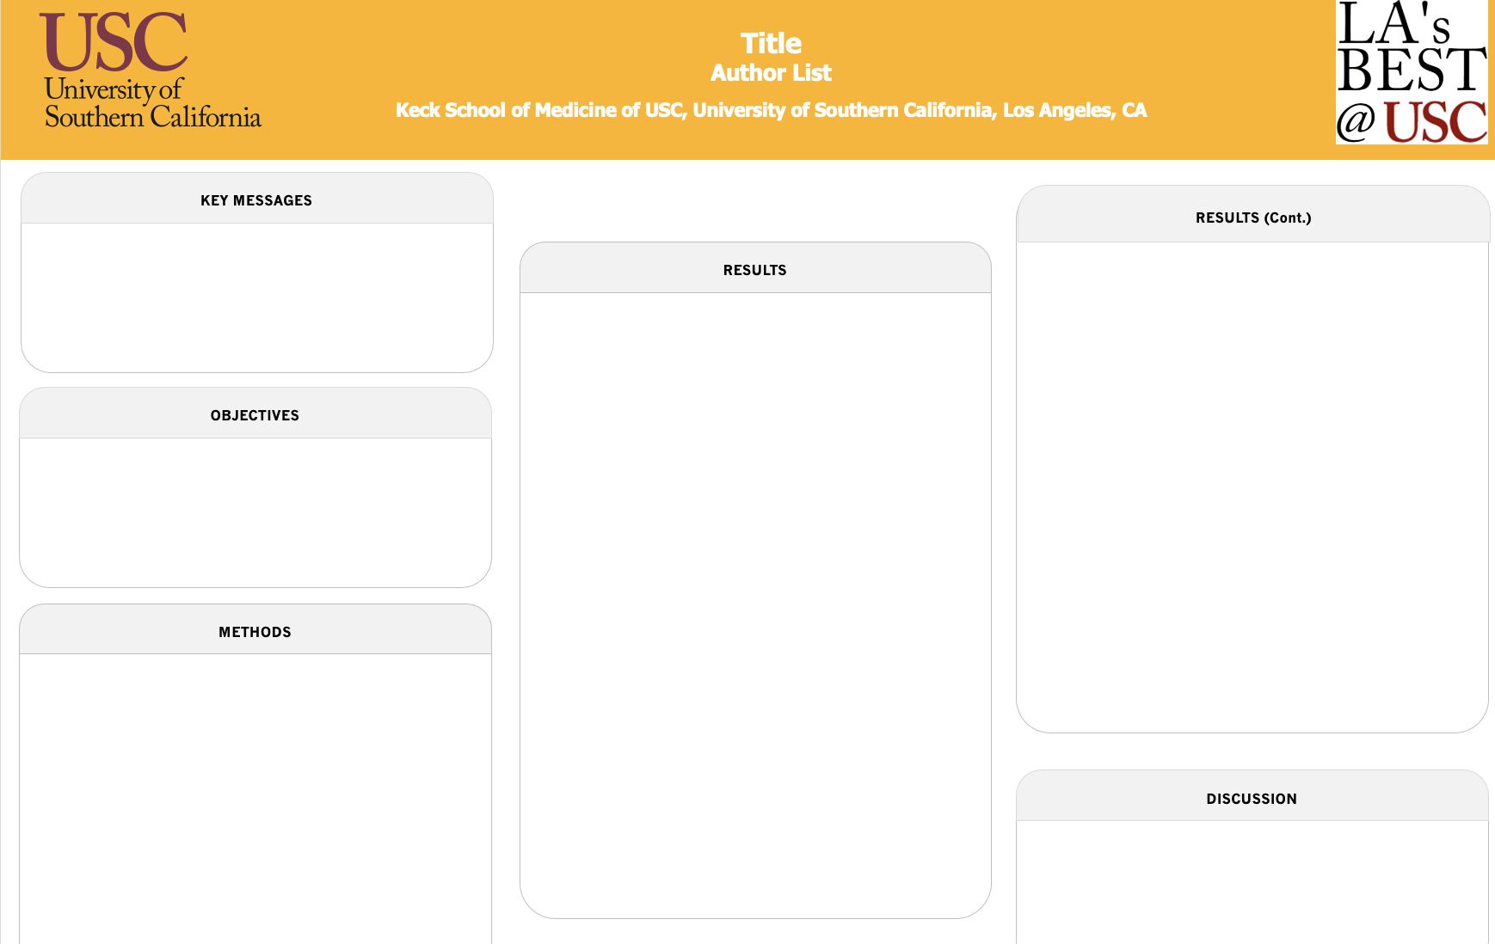
You have access to a template

Slide 28
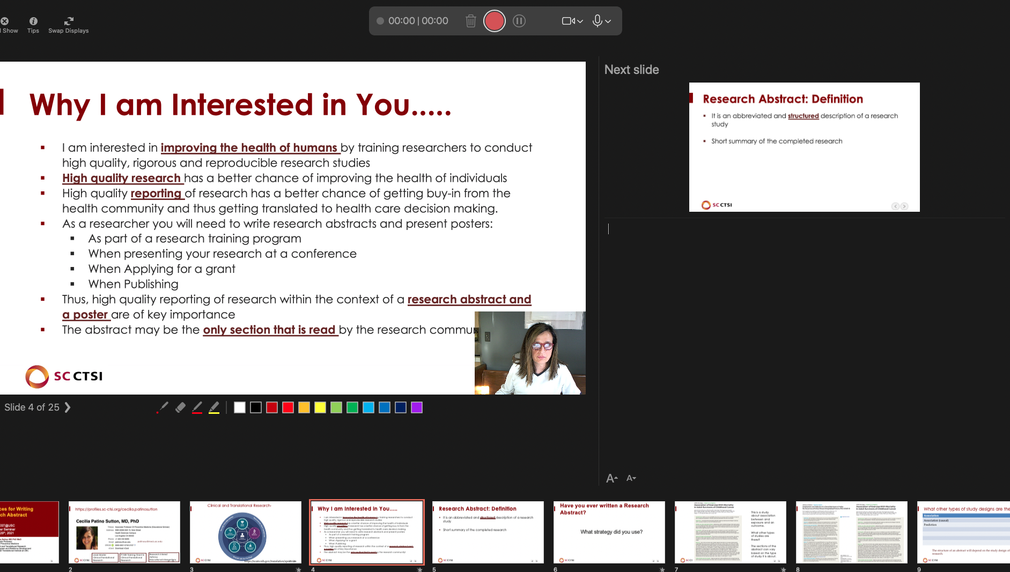
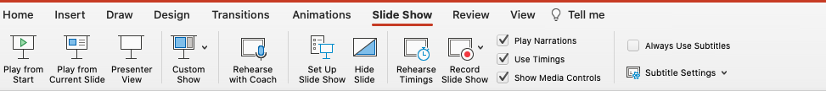
Preparing for the Oral Presentation
Decide what section each of you will present, but make sure you know all the sections
Write out what each one will say, every single word!
Practice presenting your section, many times
Use PowerPoint capabilities to practice
Record your presentation so you can evaluate and identify what sections to work on.
e.g., Write out what each one will say using
powerpoint recording capabilities.

Slide 29
Let’s summarize what we learned
Posters that are clear and concise do not intimidate the audience
Practice and write down every word you are going to say. PRACTICE!
You should know all your team’s parts in case something happens on the day of the presentation
Keep it easy to read, use graphs and tables, avoid word overload
Take advantage of Powerpoint capabilities.

Slide 30
Exercise: if we have time
Get into your research groups
Identify key roles for preparing the poster and oral presentation, e.g.,
Preparing the Content
Creating the poster
Creating the powerpoint presentation
Deciding who will present what
Record your presentation and adapt
Practice schedule

